Slide 1
A year in to the revised IPM Plan
- do you know your score?
Spencer Collins
Senior Plant Health Adviser

Slide 2
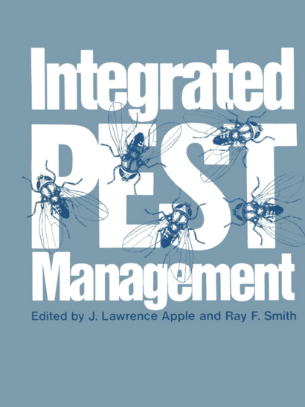
What is IPM?
Not a new concept
Agronomic practices
  Cultivation techniques
  Resistant/tolerant cultivars
  Hygiene measures
  Balanced fertilisation and irrigation practices
  Protection and enhancement of beneficial organisms
Integrated Pest Management, 1976

Slide 3
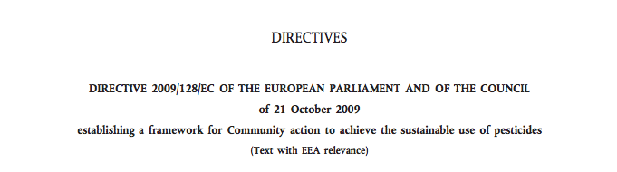
Integrated Pest Management and Sustainable use of Pesticides
“Emphasises the growth of healthy crop with the least possible disruption to agro-ecosystems and encourages natural pest control mechanisms”

Slide 4
Integrated Pest Management
Prevent
Detect
  Thresholds
Control
  Biological, physical and other non-chemical methods preferred
  Specific for target
  Only when necessary
  Consideration made to avoid resistance developing
Assess

Slide 5
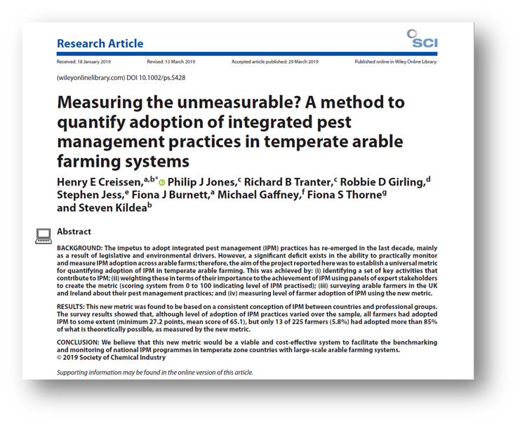
How to measure level of IPM implementation

Slide 6
New-improved IPM plans
Designed to allow farmers and growers to demonstrate implementation of IPM, recording all aspects of pest management
  Prevent, Detect, Control, Assess
Provides assurance of sustainable use of Plant Protection Products in UK crop production
Produces an IPM score allowing evaluation of practices to improve and develop IPM planning

Slide 7
IPM plans
Broad acre
Released December 2020
Grassland
Integrated Weed Management
Horticulture
Coming soon…

Slide 8
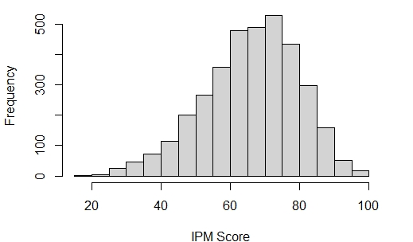
Broad acre – 3,633 completed
Grassland – 215 completed

Slide 9
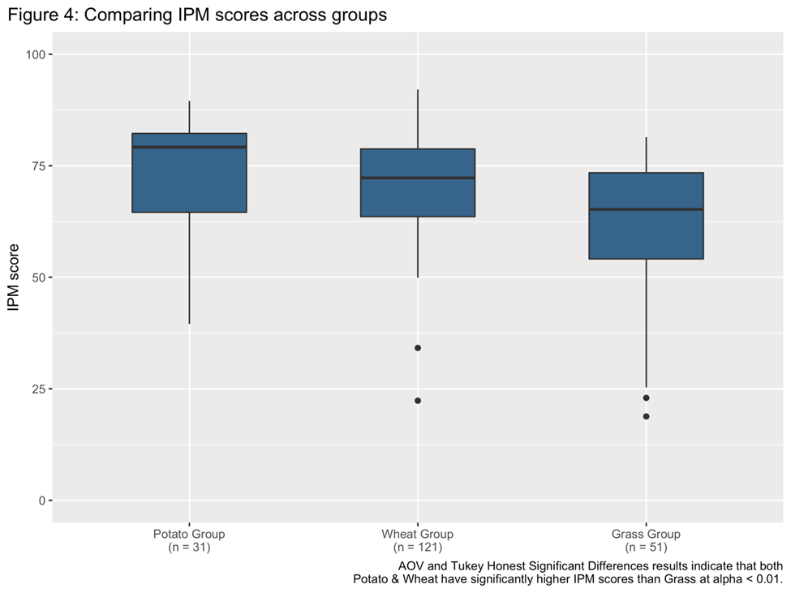
Improve year on year
Feedback given to promote increased IPM implementation
Results will focus knowledge transfer that will have the greatest impact
IPM plans will continue to improve
Understand barriers to uptake of IPM
  Economics
  Lack of Knowledge and/or Experience

Slide 10


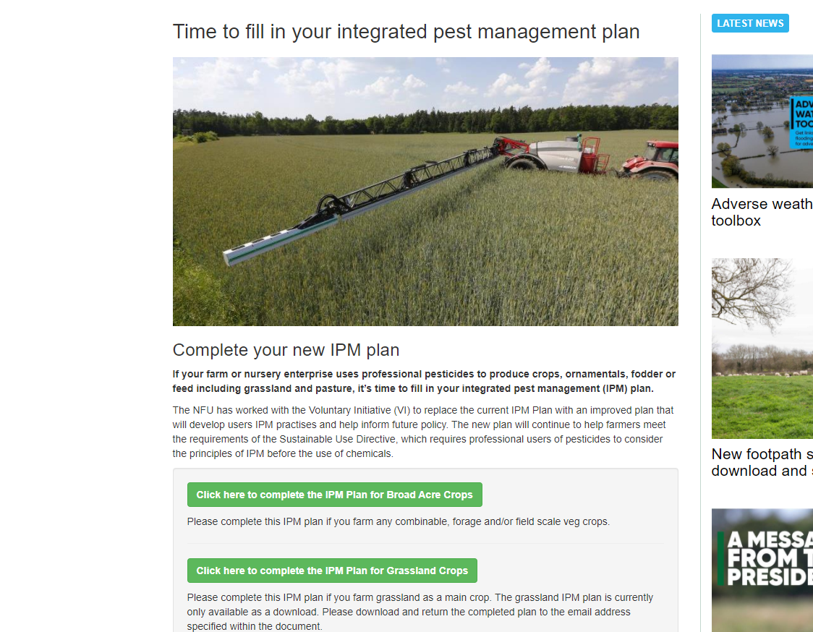
Thank you
Spencer Collins
Senior Plant Health Adviser
NFU
Agriculture House
Stoneleigh Park
Warwickshire
CV8 2TZ
Mob: 07917 736004
Email: Spencer.Collins@NFU.org.uk

